Slide 1
Clinical Trial Regulations and Guidelines
&
Quality in Clinical Trials:
How to Remain in Compliance
Michelle Savoie, Manager, Office of Compliance and Oversight
Clive Hansen, Manager Office of Audits, Inspections and Partner Compliance

Slide 2
Agenda
Overview of clinical trial regulations and guidelines
History
Current state
What this means for you as an investigator
Quality processes at CCTG
Central Monitoring
On-site Monitoring
Audit
Inspections
Examples of inspection observations

Slide 3
Objectives
List the organizations and documents that define the regulatory standards in Canada
Identify investigator responsibility according to applicable Regulations and Guidelines
Describe quality management systems

Slide 4
Which Regulations & Guidelines apply?
Criteria | Regulations & Guidelines
All research involving human subjects | Nuremburg Code Declaration of Helsinki ICH Good Clinical Practice Local Requirements (e.g. REB)
Human research funded by Canadian federal granting agencies (e.g. CIHR) | Tri Council Policy Statement (TCPS)
Clinical Trials Involving Drugs | Canada – Food and Drugs Act US – FDA Regulations
Clinical Trials Involving Natural Health Products | NHP Regulations
Clinical Trials Involved Medical Devices | Medical Device Regulations
Human research funded by US federal funds (e.g. NIH) | US Federal Regulations (e.g. OHRP) Clinical Trial Monitoring Branch Guidelines (CTMB)

Slide 5
Nuremburg Code
10 standards physicians must conform to when carrying out experiments on human subjects
Key principles include but are not limited to:
Informed consent
Research must be necessary and based on prior animal experimentation
Risk is proportionate to importance
No unnecessary physical/mental suffering
Freedom to withdraw at any time

Slide 6
Declaration of Helsinki
Medical progress is based on research, research improves treatments and understanding of disease but involves risks and burdens, and therefore must be subject to ethical standards
Key principles include but are not limited :
Content of protocol
Consent of the informed consent form
Independent ethics review
Well being of subject overrides science and society
Participation is voluntary and informed
Informed Consent requirements
Protection of privacy and confidentiality of subjects
Publication requirements

Slide 7
Tri Council Policy Statement
Joint policy of Canada’s three federal research agencies – the Canadian Institutes of Health Research (CIHR), the Natural Sciences and Engineering Research Council of Canada (NSERC), and the Social Sciences and Humanities Research Council of Canada (SSHRC)
1st TCPS came out in 1998
Revised to TCPS 2 (2018) modified in 2020
Key principles
Respect for Persons
Concerns for Welfare
Justice
Includes, but not limited to:
Informed consent
REB
Privacy
Genetic research
Research involving First Nations, Inuit and Metis peoples

Slide 8
Conduct of Clinical Trials in Canada

Slide 9
Canadian Food and Drug Regulations
Health Canada Food and Drug Act (FDA)
Food and Drug Regulations (FDR), Division 5 “Drugs for Clinical Trials Involving Human Subjects”
Came into effect on September 1, 2001
Includes GCP (C.05.010)
Applies to all Phase I to Phase IV clinical trials
GUI 100
Released 2019. Guidance Document: Part C, Division 5 of the Food and Drug Regulations “Drugs for Clinical Trials Involving Human Subjects”
Link: https://www.canada.ca/en/health-canada/services/drugs-health-products/compliance-enforcement/good-clinical-practices/guidance-documents/guidance-drugs-clinical-trials-human-subjects-gui-0100.html

Slide 10
Canadian Food and Drug Regulations
Marketed agents used outside of their approved use in Canada require a Clinical Trial Application (CTA)
E.g. clinical use, dose / formulation, route of administration or target patient population
CTA submissions include
Drug information, protocol, consent, product monograph/ Investigator’s Brochure, safety information, required forms
30-day review period by Health Canada
No Objection Letter (NOL) = trial can proceed
Or Clarifax = additional information must be submitted to Health Canada

Slide 11
International Conference on Harmonization of Technical Requirements for the Registration of Pharmaceuticals for Human Use (ICH) Efficacy Guidelines
ICH Guidelines relevant to clinical trial conduct
E1: Clinical Safety for Drugs used in Long- Term Treatment Prolongation
E2A-E2F: Pharmacovigilance
E3: Clinical Study Reports
E4 Dose Response Studies
E5: Ethnic Factors
E6: Good Clinical Practice
E7: Clinical Trials in Geriatric Population
E8: Considerations for Clinical Trials
E9: Statistical Principles for Clinical Trials
E10: Choice of Control Group in Clinical Trials
E11: Clinical Trials in Pediatric Populations
E12: Clinical Evaluation by Therapeutic Category
E14: Clinical Evaluation of QT/QTC Interval
E15: Definitions in Pharmacogenetics/ Pharmacogenomics
E16: Qualification of Genomic Biomarkers
E17: Multi-Regional Clinical Trials
E18: Genomic Sampling

Slide 12
ICH Good Clinical Practice
Overview
1. Glossary
2. Principles
3. REB responsibilities
4. Investigator responsibilities
5. Sponsor responsibilities
6. Protocol and amendments
7. Investigator’s Brochure
8. Essential Documents
Principles
Ethical principles
Benefits/risk
Rights/safety most important
Drug info supports trial
Trial scientifically sound, protocol
Protocol REB approved
Medical care by a qualified MD
Qualified individuals conduct trials
Free informed consent
Data accuracy
Confidentiality
Drugs: GMP/protocol
Quality assurance

Slide 13
ICH-GCP E6(R2) Investigator Responsibilities

Slide 14
ICH-GCP E6: Investigator Responsibilities
4.1 Qualifications and agreements
4.2 Adequate resources
4.3 Medical Care of Trial Subjects
4.4 Communication with IRB/IEC/REB
4.5 Compliance with Protocol
4.6 Investigational Product(s)
4.7 Randomization Procedures and Unblinding
4.8 Informed Consent of Trial Subjects
4.9 Records and Reports
4.10 Progress Reports
4.11 Safety Reporting
4.12 Premature Termination or Suspension of a Trial
4.13 Final report(s) by Investigator

Slide 15
Investigator Responsibilities
Adequate Resources
Qualified team and facilities to carry out trial (GCP 4.2):
Completion of eCRFs- accurate data entry
Collecting correlative samples
Preparing documentation for REB communication
Documenting transactions of investigational agent
Calibrated equipment and temperature monitoring in pharmacy
Medical care provided (GCP 4.3):
Determine patient eligibility for the trial
Make treatment decisions: GO no GO to next cycle/treatment
Manage AEs and any associated dose modifications

Slide 16
Investigator Responsibilities- CONT
Conduct trial in compliance with the protocol (GCP 4.5)
Tools for protocol investigations/schedule e.g. checklist/worksheets
Oversee process for team training on protocol and any updates
Report deviations from the protocol and develop corrective action to prevent future deviations
Informed Consent of Trial Subjects (GCP 4.8)
Ensure patient consented prior to trial related activities and informed consent discussions are documented
If the participant is unable to read or understand the document language, an impartial witness or interpreter can assist
Re-consent of patients is conducted timely when new information that could impact patient’s willingness to continue participation
Oversee process to ensure patients are informed of new information

Slide 17
Investigator Responsibilities
Accountability of Investigational Medicinal Products (GCP 4.6)
Often delegated task and oversight still needed to ensure for e.g. used in accordance with protocol, correct storage, correct accountability logs
Records and Reports - Maintain adequate and accurate source documents (GCP 4.9) and trial records that are:
Attributable
Legible (much easier now with EMRs!)
Contemporaneous
Original
Accurate
Complete
Participant trial-related documents and medical records must be available for review by monitors, auditors, REB, and the regulatory health authority (GCP 4.9)

Slide 18
Investigator Responsibilities
Safety Reporting (GCP 4.11)
All Serious Adverse Events (SAEs) must be reported immediately to sponsor. The clock starts ticking as soon as the investigator is made aware- 24 hours to report!
Document causality/relatedness of SAE(s) for your study team for reporting and assist with any sponsor questions and follow up reports.

Slide 19
Investigator Versus Sponsor Responsibilities
Investigator
Adequate resources & qualifications
Contracts
Informed Consent
Randomizing/Unblinding
Medical care of trial subjects
Compliance with Protocol
Communication with REB
Investigational Medicinal Product (IMP)
Records and reports including Investigator Site File
Local safety reporting
Sponsor
Trial design
Contracts and financing
Medical expertise
Protocol development
Trial management, data handling, and record keeping including Trial Master File
Investigator selection and oversight responsibilities
Notification / submission to regulatory authority
Quality assurance and quality control
Noncompliance
Premature termination or suspension
Clinical trial / study reports
Data Safety Monitoring
Final Report
Contract Research Organization (CRO; e.g drug distribution)
Inspection Coordination

Slide 20
Quality processes at cctg

Slide 21
Quality and Safety
Processes based on regulations and guidelines
On-Site Monitoring
& Auditing
Central Monitoring
General trial Oversight
Patient Data:
Informed consent
SDV
Protocol Compliance
Centre SOPs
Essential & Ethics Documents
Pharmacy
General trial Oversight
Patient Data:
Informed consent
SDV
Protocol Compliance
Pharmacy
Essential & Ethics Documents
Centre Facilities
Protection of trials participants
High Quality data
Compliant trial conduct

Slide 22
Central Monitoring

Slide 23
Site Selection Requirements
Credentialed QI
Established patient population
Adequate Resources
SOPs to conduct clinical trials
Demonstrated commitment to support CCTG trials
Established system for ethics review
Access to adequate laboratory facilities
Documentation of delegated tasks and required roles (RIPPLE)
Confirmation of required training for all centre personnel (GCP, Div 5, etc.)
CVs for all centre investigators
REB membership list
FWA number

Slide 24
Investigator Selection
CCTG credentials investigator based on review of CCTG Investigator Registration Form and submitted CV
Qualified investigator for trial provides following:
Signed protocol signature page
REB favorable approval of Protocol which includes agreement to conduct trial per GCP
Qualified Investigator Undertaking form (for investigators participating on trials under Clinical Trials Application in Canada)

Slide 25
Monitoring
Submitted to CCTG
Programmatic checks
Manual checks
On-site checks
CRF Data
Queries Issued
Protocol Compliance Assessed
Deviations/Violations Assigned

Slide 26
On Site Monitoring

Slide 27
On-Site Monitoring Scope Standard Monitoring (OSM-C)
CCTG’s standard on-site monitoring program applies to:
CCTG member and single-study centres in Canada
Conducted at 100% of accruing sites
Based on CTMB guidelines but is more intensive with regards to both trial selection and visit frequency, using a risk-based approach
In addition, CCTG has another intensive on-site monitoring program for select high risk/complex trials.

Slide 28
Risk-Based Centre Selection and Visit Frequency
Centre | Timing
Centres conducting pediatric trials | Within 6 to 12 months of first participant accrued
Centres conducting IND (phase I/II) trials | Annually
Centres with high accrual (>30) | Annually
Centres with unacceptable ratings on CPI, monitoring or auditing, or flagged by trial team | Within 12 months of unacceptable visit. Note: May be deferred to 18-24 months where appropriate (e.g., limited activity, CTMB approval)
New Centres | Within 18 months of first participant accrued
All other centres | Minimum of every 36 months

Slide 29
Trial Selection Standard Monitoring (OSM-C)
Trial | Selection and Timing
Phase I/II trials or pediatric trials (with or without CTA) | Annual visits; Minimum 10% of cases; Trial selected at each visit while active; Trial may also be selected in follow up or to assess prior issues
CTA trials or Complex trials (with or without CTA) | Routine visits; Select at trial at each visit while active until a minimum of 10% of cases have been selected; If slow accruing select cases early, mid and late in the accrual process when feasible
NCTN trials | Minimum per CTMB guidelines
All other trials | Selected if feasible in order to ensure 10% of cases are monitored
Trials with unacceptable prior findings, or trials flagged by CPI or trial team | Each visit while trial is active and continues to have unacceptable ratings; Generally > 10% will be selected if issues identified

Slide 30
Key Monitoring Activities Standard Monitoring (OSM-C)
Component of Review | Monitoring Activities for All Selected Trials/Cases
REB/Informed Consent | -Informed Consent required element review -100% of documents which sites are required to notify their REB about as the submission of these are not centrally reviewed -10% sample of REB approvals (eg. protocols, consents)
Essential Docs | -10% sample (eg. delegation log, enrollment log, screening log)
SOPs | -Each Centre
Pharmacy | -100% review/reconciliation for CTA/supplied agent
Patient | -Protocol compliance review -100% Source Data Verification (SDV) of a sample of data* -Unannounced cases will be reviewed (pending accrual)
*Sample for SDV: Eligibility/Baseline, Minimum of one treatment CRF/EDC folder (minimum of two on treatment CRF/EDC folder for Phase I/II IND trials), Serious Adverse Events, Endpoints of the study (progression, response, Death)
.

Slide 31
Monitoring: The act of overseeing the progress of a clinical trial, and of ensuring that it is conducted, recorded, and reported in accordance with the protocol, Standard Operating Procedures (SOPs), Good Clinical Practice (GCP), and the applicable regulatory requirement(s). (1.38)
Audit: A systematic and independent examination of trial related activities and documents to determine whether the evaluated trial related activities were conducted, and the data were recorded, analyzed and accurately reported according to the protocol, sponsor's standard operating procedures (SOPs), Good Clinical Practice (GCP), and the applicable regulatory requirement(s). (1.6)
Inspection: The act by a regulatory authority(ies) of conducting an official review of documents, facilities, records, and any other resources that are deemed by the authority(ies) to be related to the clinical trial and that may be located at the site of the trial, at the sponsor's and/or contract research organization’s (CRO’s) facilities, or at other establishments deemed appropriate by the regulatory authority(ies). (1.29)
P
R
O
C
E
S
S
F
O
C
U
S
?
?
?

Slide 32
Audit

Slide 33
Audit
The purpose of a sponsor’s audit, which is independent of and separate from routine monitoring or quality control functions, should be to evaluate trial conduct and compliance with the protocol, SOPs, GCP, and the applicable regulatory requirement. (GCP 5.1.19)
CCTG audits because
Regulatory and Contractual requirements
Ensure data is ‘fit for purpose’
Look for scientific misconduct/fraud, breaches in GCP esp. patient related
Mitigate risk
Trials in novel populations (e.g. pediatric) or of novel interventions (surgery, vaccines etc.)
Pending inspections or external audits by stakeholders (e.g. preparatory audits by pharmaceutical companies)
For cause / investigations / centres or trial of concern

Slide 34
Auditing vs. Monitoring
 | Auditing | Monitoring
Focus | Focuses on process issues rather than corrections to data Independent team, looks at ALL trial related activities (including monitoring and central office and vendors) | CCTG review of the site with a focus on trial data
Scope | Selected trials, selected sites (usually highest, lowest and sites with issues) and vendors – based on risk and performance (including accrual) | All trials and all sites, as well as vendors (labs, drug warehouses). Even when risk based is more comprehensive than auditing.
Frequency | Usually specific time points of the trial and may be pre database lock or pre NDA filing. | Ongoing throughout trial
Access to reports | Limited, marked as non-disclosable To preserve the independence and value of the audit function, the HA should not routinely request the audit reports. May seek access to an audit report on a case by case basis when evidence of serious GCP non-compliance exists, or in the course of legal proceedings. (GCP 5.19.3 (d)) | Monitoring visit report is part of the essential documents for a trial. Health authorities (HA) and sponsors have access

Slide 35
Audit & Monitoring Committee
Volunteer external auditors and monitors visit member centres with CCTG staff to conduct monitoring and auditing visits
Volunteers are staff at member centres who work on CCTG trials – data managers, nurses, pharmacists and investigators
AMC approximately 60 members who attend 1-3 visits per year
If interested please email monitoring@ctg.queensu.ca

Slide 36
Inspections

Slide 37
Health Canada
Regulatory Operations and Regions Branch (RORB)
Created on April 4th, 2016
Merging of the Health Products and Food Branch Inspectorate (HPFB Inspectorate) with the Regions and Programs Bureau (RAPB)
To strengthen accountability and simplify the delivery of health product compliance and enforcement programs
Compliance Program originally designed in 2002 and HC is reviewing its Clinical Trials Compliance Program
Broad direction is to rebalance the mix of inspections to get broader coverage of phases of trials and players (sponsors, QIs, CROs, SMOs, etc.) in the clinical trials sector

Slide 38
Inspection Site Selection
Conducted under the authority of section 23 of the Food and Drugs Act
Factors that may influence site selection may include
# of trials at site
Status of trial at site
# of subjects enrolled in trial
Therapeutic area
Study population
Compliance history
++
Target 2% or approximately 80 clinical trial applications per year
Each region is assigned a # of inspections based on requirements and resource allocation
Average of 5 days in length
1-2 inspectors
While most inspections are conducted at an investigator site under a QI, they are a bilateral review of the QI and the sponsor – CCTG will assist with inspections of CCTG trials

Slide 39
Reporting (I)
Observations are recorded and assigned per Classification of Observations Made in the Conduct of Inspections of Clinical Trials( GUIDE-0043)
Observations are classified as:
Critical | Major | Minor
“Observation describing a situation that results in fatal, life threatening or unsafe conditions for subjects enrolled in a clinical trial. It presents an immediate or latent undue risk to the rights, health and safety of subjects.” | “Observation describing a marked deviation or deficiency, other than a critical one, that may result in undue health risks to the clinical trial subjects, in other persons or could invalidate the data.” | “Observation that is classified as not critical or major, but which indicates a deficiency and/or deviation from Division 5.”

Slide 40
Reporting (II)
Observations are listed and a response to each is required. The observations noted determine the overall rating for the inspection:
Compliant = “C”
Assigned when few major or only minor observations are noted
Non Compliant = “NC”
Assigned when one or more critical observations, or;
Repetitive or multiple major observations reported
Inspection findings are discussed with the review directorate
Action to be take may include suspension or cancellation of the clinical trial

Slide 41
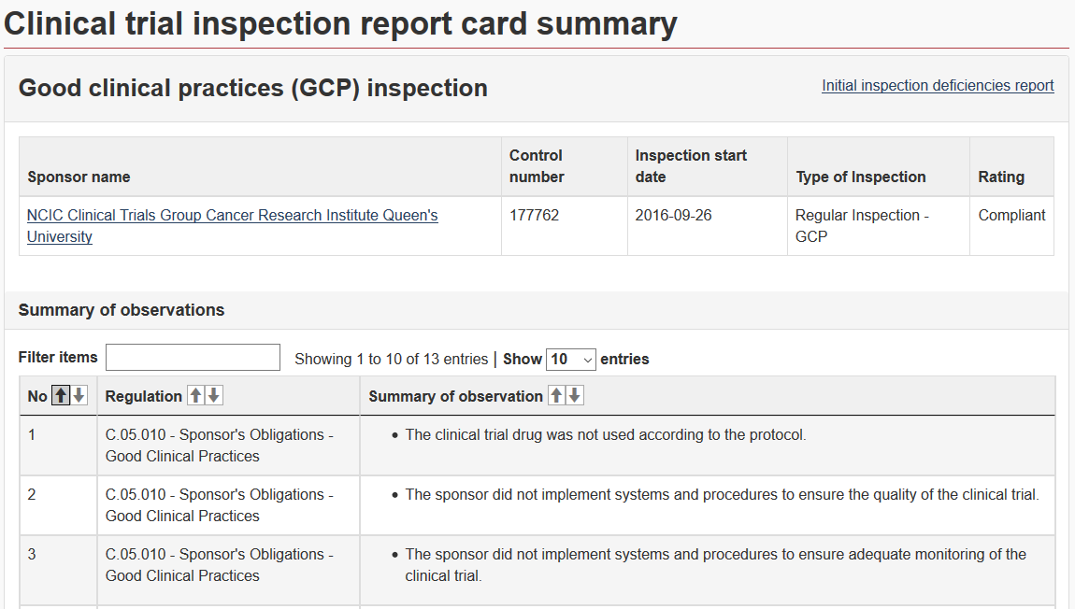
HC Drug and Health Product Inspection Database
http://www.healthycanadians.gc.ca/apps/gcp-bpc/index-en.html
Clinical Trial Inspection Results started publishing on Dec 11, 2015 - includes clinical trial inspections conducted since Jan 1, 2012

Slide 42
Examples
NB: Clinically Appropriate ≠ Acceptable

Slide 43
Observations
GCP Sponsor's obligations: C.05.010 C.05.010(b)
The clinical trial was not conducted according to the protocol.
Eligibility / baseline exams not done within protocol mandated timelines.
Documentation of review by QI prior to randomization
Abnormal results should be assessed for clinical significance.

Slide 44
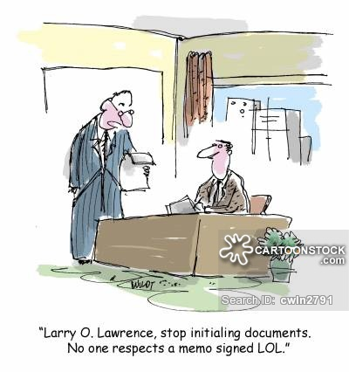
Action
Documentation should be present that the investigator reviewed investigations prior to enrolment / treatment
Review can be documented by initialing the report or by commenting in the dictated note, including clinical significance.

Slide 45
Observations
GCP Sponsor's obligations: C.05.012 C.05.012(1)
The clinical trial records had errors and/or missing information that did not allow for complete and accurate reporting, interpretation, and verification

Slide 46
Action
Documentation must be present to confirm the protocol was followed.

Slide 47
Observation
GCP Sponsor's obligations: C.05.010 C.05.01O(j)
The drug was not handled and stored in keeping with Good Manufacturing Practices
After overlabeling with the new label, the old expiry date was not obscured resulting in the label displaying two expiry dates.
As per site's Master Drug Accountability Log, study drug kits were overlabelled whereas as per the record they were already dispensed – the labelling done lacked oversight including the number of kits overlabelled.

Slide 48
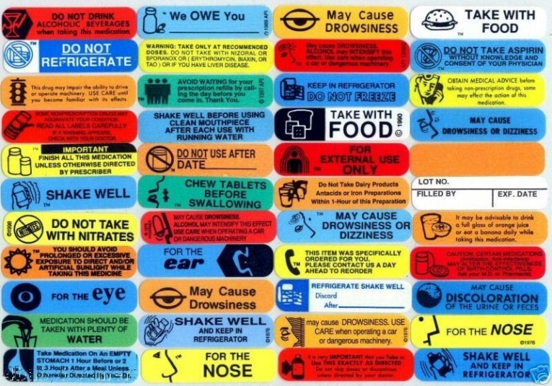
Action
Ensure only one expiry date is present
The DAL should only record kits being relabeled that were not dispensed prior to the relabeling.
Updated templates for relabeling have been developed by CCTG.

Slide 49
Trial not Conducted in Accordance to the Protocol
Day 1 cycle 7 chemotherapy dose not reduced as per protocol. Prednisone local standard dose of 100mg/m2 five times daily given, although protocol dose maximum is 40mg/m2. Patient received 200mg study drug on cycle one and cycle two however protocol mandates dosage be capped at 150mg.
Quality of Life Questionnaires assessments of subjects were not being performed on day of planned study drug infusion/treatment as required by the protocol. Site's practice was to perform all assessments on the previous day, followed by study drug infusion the next day.
Per GCP 4.5 the investigator should conduct the trial in compliance with the protocol agreed to by the sponsor…
While the care provided to the patient was clinically appropriate the protocol must be followed! (the QoL was administered as expected by CCTG, but not as per protocol). Any permissible variances should be documented (there may be exceptions for a deviation from the protocol due to patient safety, however, this must be clearly documented).

Slide 50
Investigator Oversight: Abnormal Tests
Clinical Significance of abnormal value of Total Bilirubin on lab results marked "H" at Week 28 Visit on 27-Sep-20XX was not reviewed and assessed by QI. It may be noted similar abnormal values were also reported for this subject at preceding visits on 1-Jun-20XX, 29-Jun-20XX, and 3-Aug-20XX at Weeks 12, 16 and 20 visits respectively.
Documentation is lacking to indicate that Lung Function Tests (at screening) within 14 days of randomization was reviewed by QI prior to randomization.
Per GCP 4.3.1 and 4.3.2 the investigator is responsible for all trial related medical decisions and should ensure that medical care is provided to a subject for any adverse events, including clinically significant laboratory values, related to the trial. Inspectors review documentation that these responsibilities have been fulfilled.

Slide 51
Investigator Oversight: Adverse Events
For the site Adverse Event Log documenting AEs, the following was noted: There was no evidence as to when the events were noted. Some events (according to the form) took place in Aug. 20XX but were not assessed by the QI before Oct, 20XX. The noted form was also deficient in the there was no provision to judge the event (by the QI) as to be expected/ not expected and serious/ not serious.
The Adverse Event (AE) forms seem to be completed by the study coordinator or study nurse, including severity and causality, with the sub-Investigator signing the first page of the form later.
For example:
At 6 month visit on 16-Feb-20XX, form signed by sub-I on 01-Mar-20XX
At 9 month visit on 11-May-20XX, form signed by sub-I on 19-May-20XX
At 18 month visit on 15-Feb-20XX, form signed by unknown person (signature did not seem to match with delegations log) on 27-Feb-20XX.
Similar to abnormal lab values, the inspector reviews documentation that the investigator has assessed adverse events in a contemporaneous manner. This may be any investigator delegated this duty but no other role (nurse, data manager, etc.) can assess causality or grade of adverse events or clinical significance of abnormal lab values.

Slide 52
Modernization of Clinical Trials
Proposals for Consideration:
Agile Life Cycle:
Enable Health Canada to oversee safe conduct of a trial in its entirety
Authorize a trial and not just import/sell a product
Single authorization for multiple product types
Streamline applications, review periods and increase efficiency
Enable sponsors to conduct innovative trials (e.g. master protocols)
Streamlining requirements across product types
Some provisions from the COVID-19 Interim Order may be incorporated

